Slide 1

United States Presidential Inaugurations Project
Csc 10800: Foundations of Data Science Fall 2024
Yeffry Zhumi

Slide 2
On April 30, 1789, the first U.S. president, George Washington, was inaugurated in New York City. Following this, the U.S. Constitution mandated that the president must take an oath of office before assuming duties, typically held on January 20 after the election. These oaths are presented as speeches delivered at the start of the president's term, with full solemnity, emphasizing the serious commitment to uphold the responsibilities of the office and serve the nation. Inaugurations then became a tradition in US History implementing it into every future presidential elections. What began as a simple speech to the nation has evolved into a significant ceremony for all Americans to witness. With the introduction of multimedia, these inaugurations have reached new heights, allowing everyone to watch the event on television.
HISTORY

Slide 3
WHY?
Presidential inaugurations are important because they represent a sense of formality during the peaceful transfer of power within the U.S. government. They also reflect the intentions and commitment of the incoming president, aiming to earn the public's trust and assure us of their dedication to keeping the country safe. These ceremonies are highly formal, and even though political parties may have different viewpoints, they all share the common goal of making our country strong and secure.
Notes:
Consider talking about:
Dates
Locations
Organizers
Attendees
Communication

Slide 4
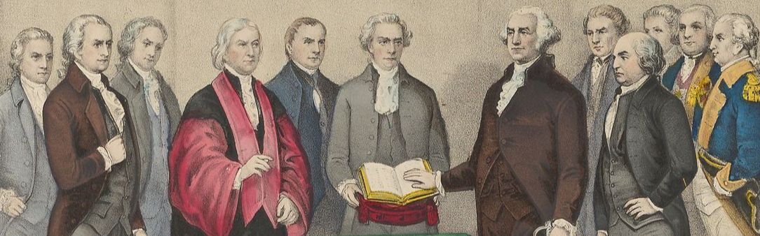
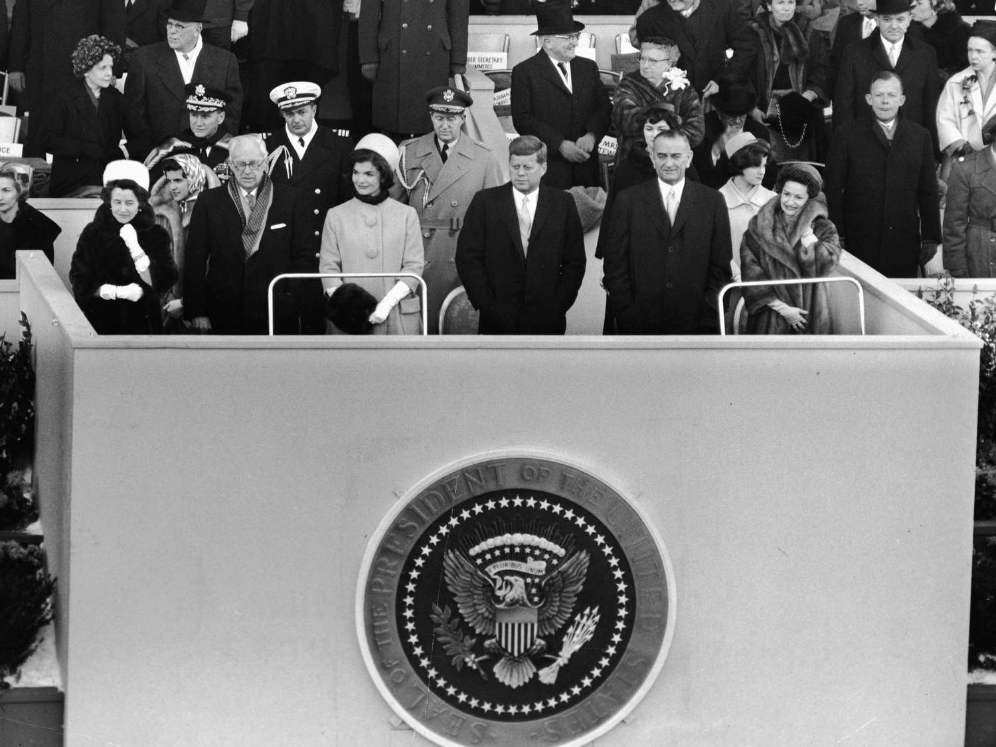
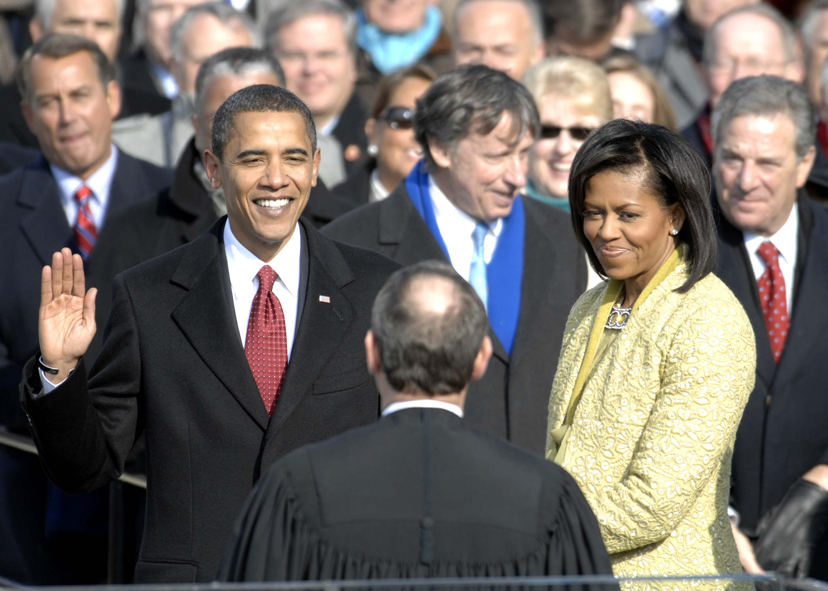
Historical Photos
Notes:
Consider talking about:
Oaths of office
Inaugural address
Prayers
Poems

Slide 5
Objective
what are common goal based on historical presidential inauguration speeches?
How can we explore this dataset?

Slide 6
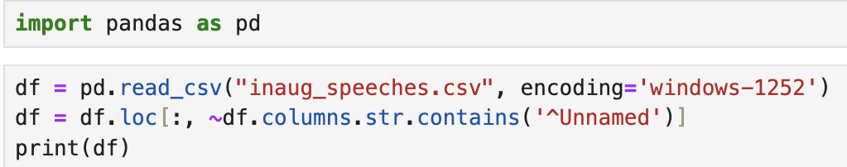
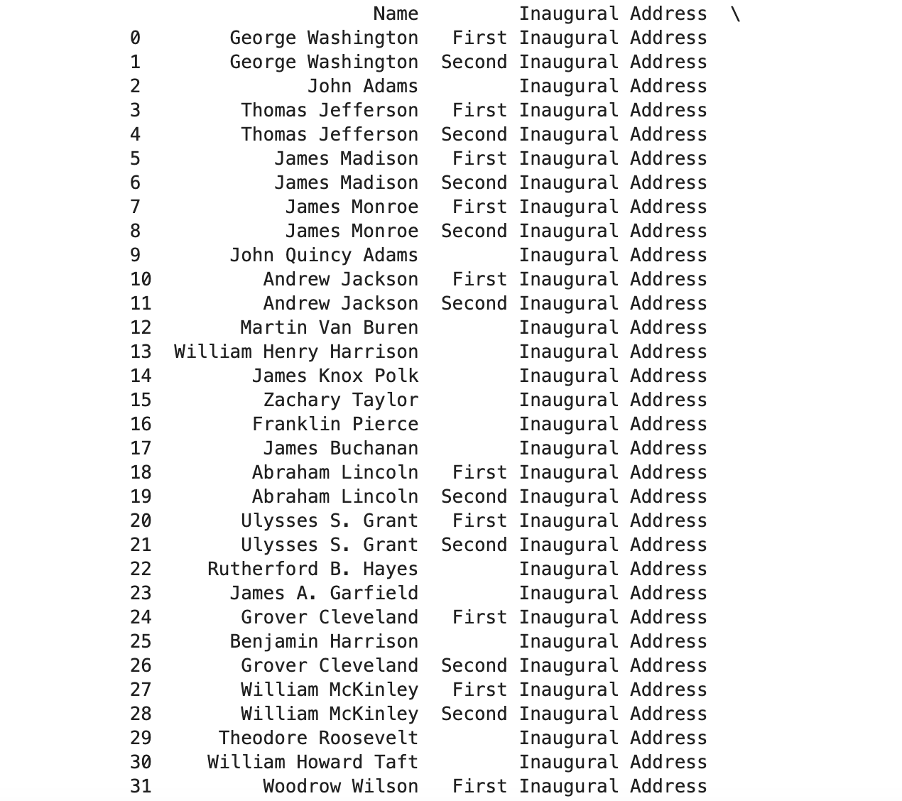
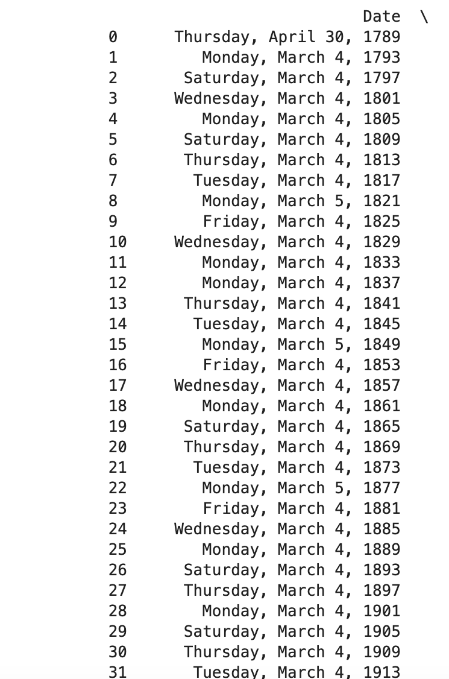

Slide 7
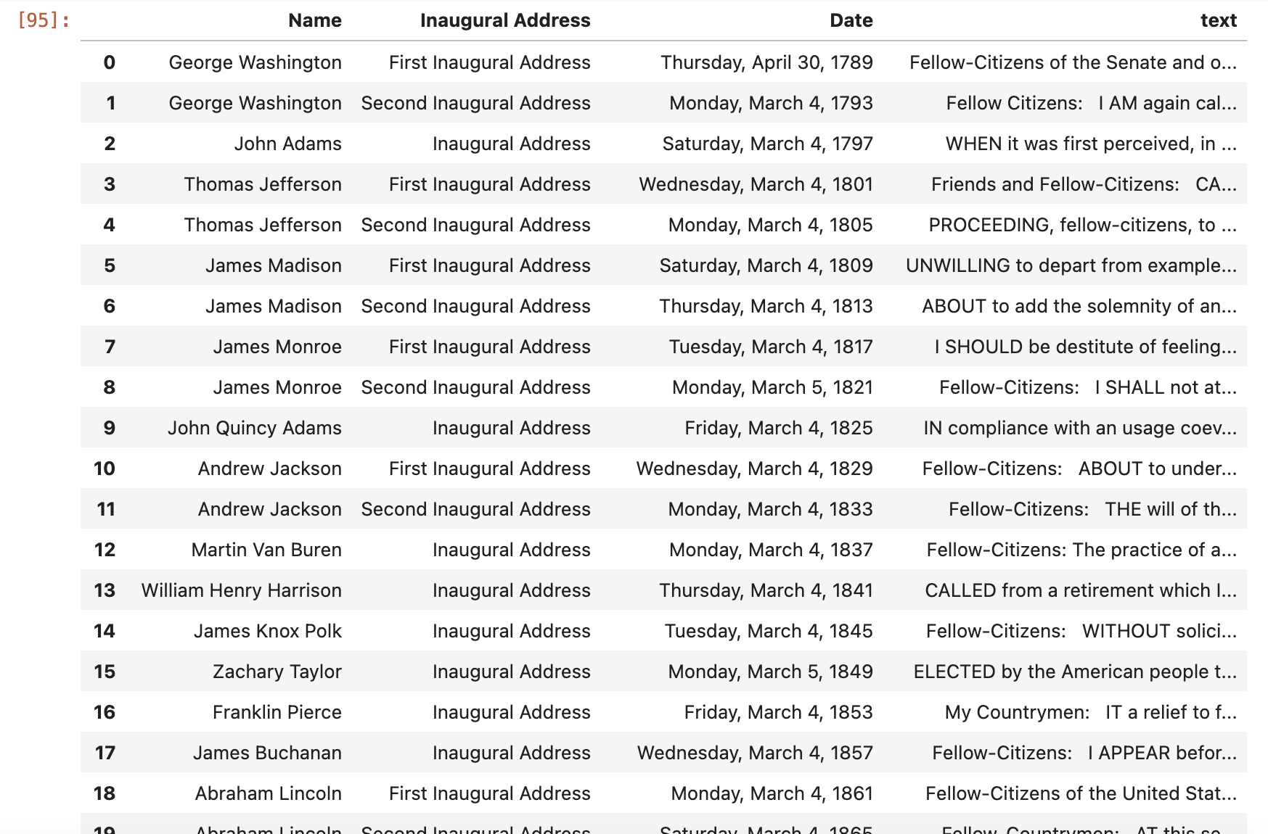

Slide 8
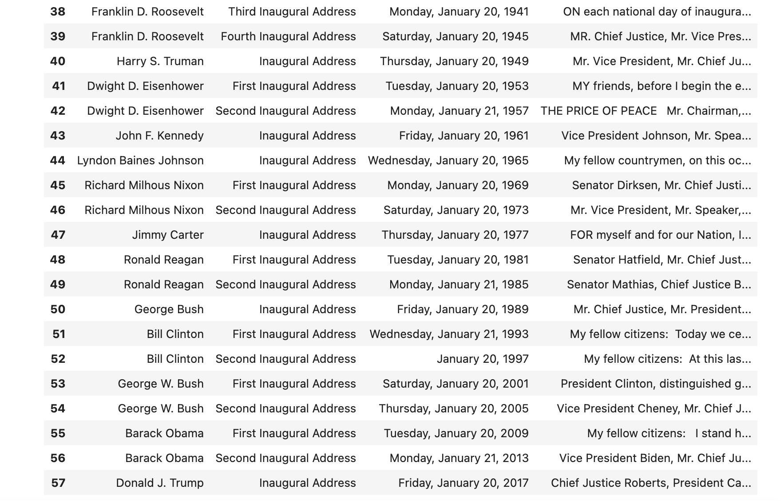

Slide 9
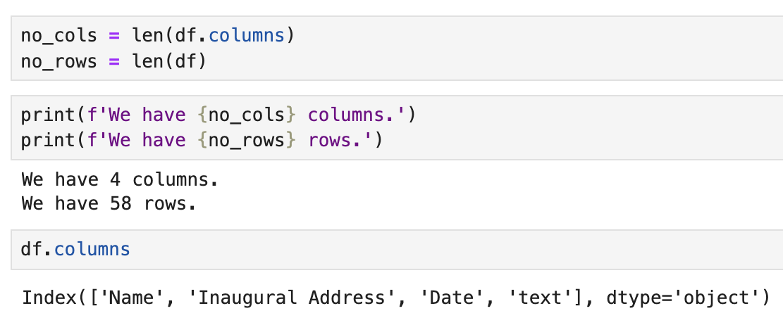
COLUMNS
Name: name of the President elected for term
Inaugural Address: number of addresses given/terms
Date: day, month and year of inauguration
Text: the actual speech given to the public

Slide 10
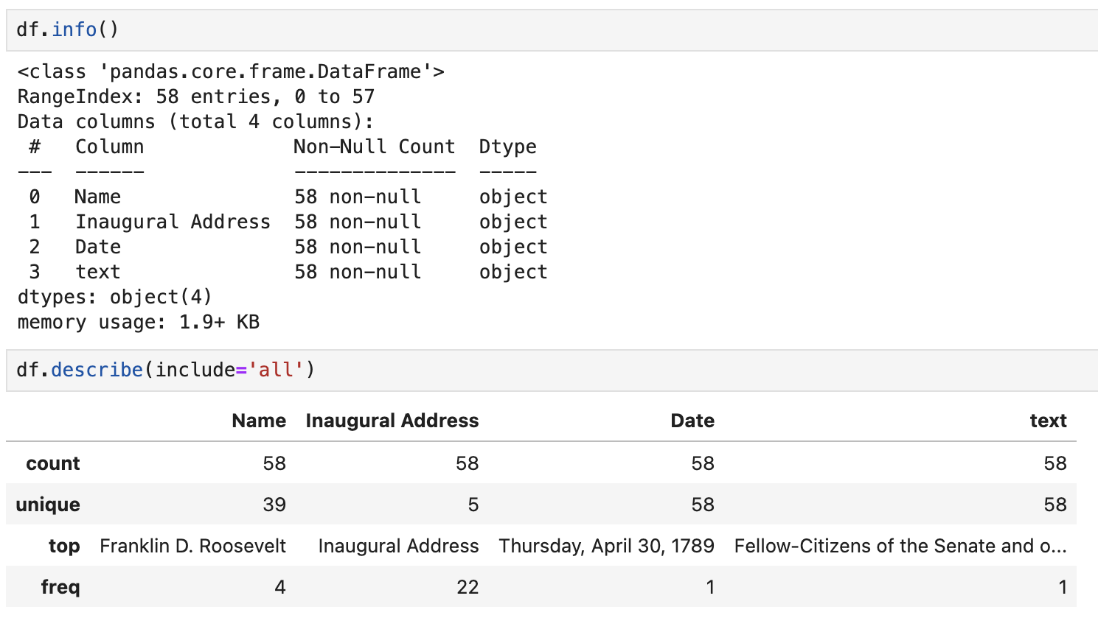

Slide 11
Observations
Column “Name” the most occurring name is Franklin D. Roosevelt and it appears 4 times, making him the president with most addresses given/and terms
Column “Inaugural Address” the most addresses given per term is one meaning most presidents served for one term
Column “date” the earliest recorded and first ever address given
Column “text” most common opening words are “fellow citizens of the Senate and of the House of Representatives” Other common words or themes are emphasizing on uniting the country, freedom, justice, peace, and change

Slide 12
NAME

Slide 13
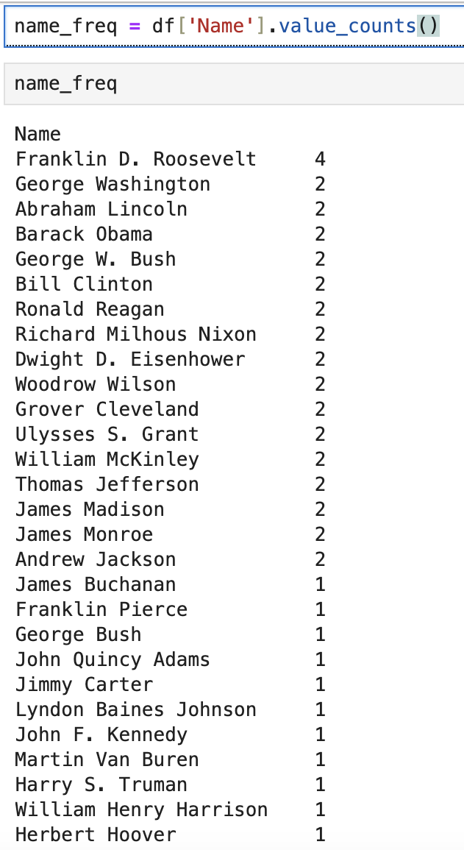
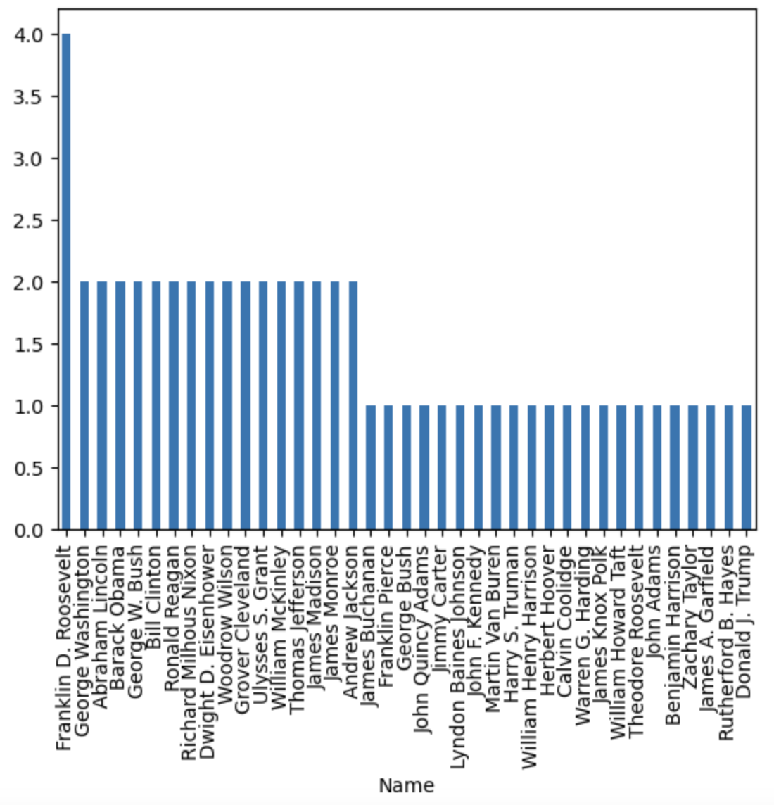

Slide 14
Inaugural Addresses

Slide 15
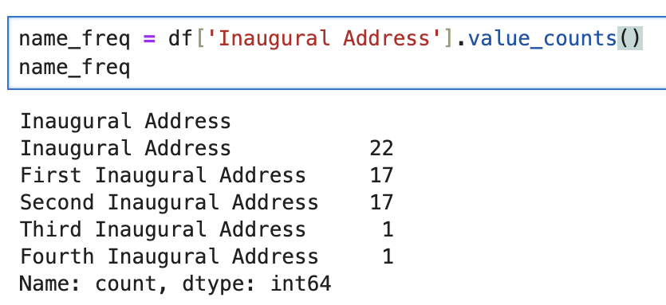
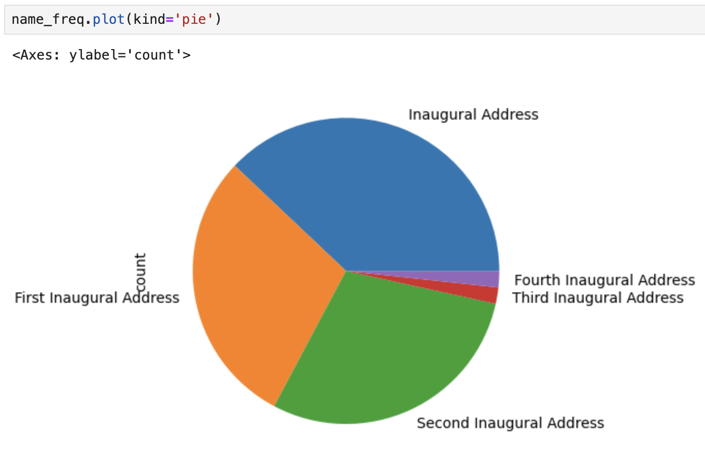

Slide 16
DATE

Slide 17
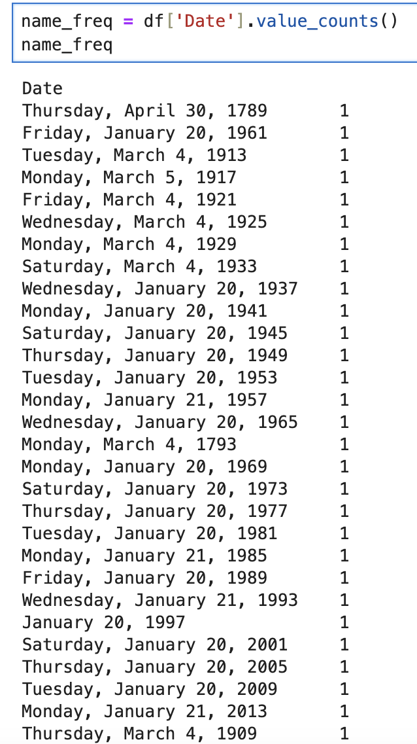
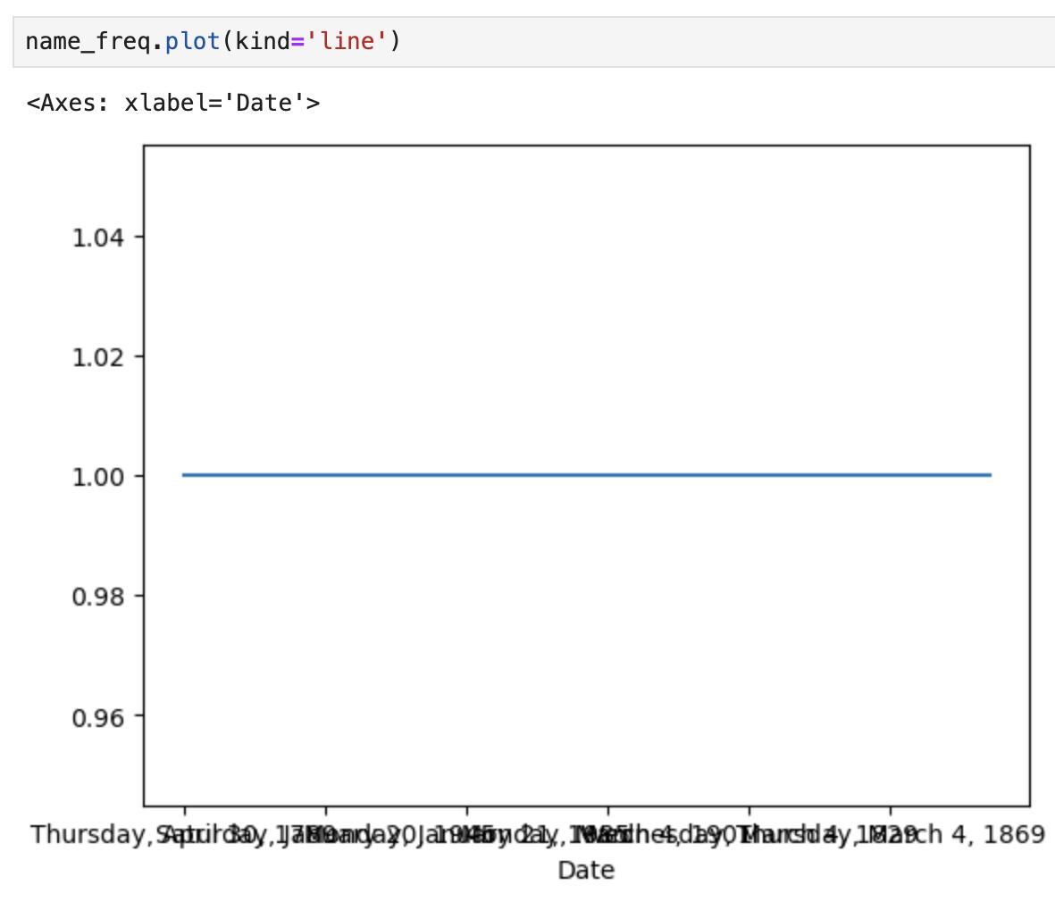

Slide 18
text
I decided to not include the text due to the enormous number of words that will take up a lot of space. But in summary it just stated that the most common words were the opening phrases which I stated before to be “fellow citizens of the Senate and of the House of Representatives”. Other themes/words such as unity, freedom, peace, trust, and change have been mentioned more than once

Slide 19
21st Century
For this part I wrote a code that focused on one column being “Date” and wrote an additional code that restricted the year from 2000 to 2017. This way I'm able to see if there was any presidents in the 21st century that served two terms and have given two inaugural addresses. The output resulted in two presidents. George W. Bush & Barack Obama

Slide 20
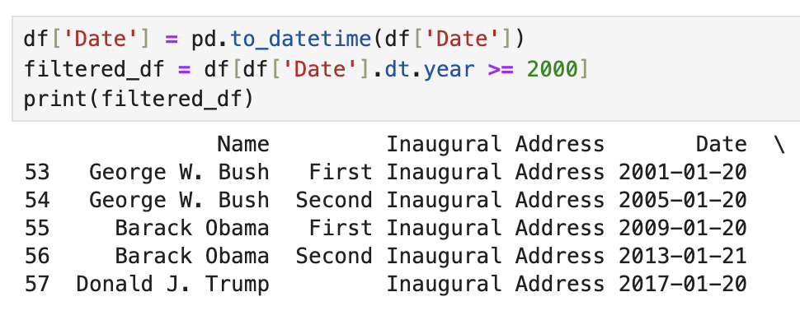

Slide 21
Closing Statements
The Inauguration Address data set has provided us with information on who were elected president of the Unites States and for how long
Also, we determined common goals on what presidents had in mind during their term run
We also played around with code to determine specific information which was later transferred into visual analysis

